Slide 1
Indigenous Thrust Stand for Drone Propulsion Systems
Presentation by
Srividya Prasad, Siddharth D Srinivas

Slide 2
Tyto Robotics Series 1585 Thrust Stand
Thrust stand for designers of UAVs, drones and other propulsion systems using brushless motors.
Features - USB interface and powerful software for automated control and data-logging.
Measurements
Derived Data
Tests
Features
Thrust (5 kgf)
Torque (2 Nm)
RPM
Temperature
Motor winding resistance
Accelerometer on PCB
Voltage
Current
Mechanical power
Electrical power
Propeller efficiency
Motor efficiency
System efficiency
Step test
Ramp test
Endurance test
Determine motor KV
Calculate motor poles
Manual control
Automatic control
Export data to .CSV
UDP Connection
Set safety cut-offs
Set working units

Slide 3
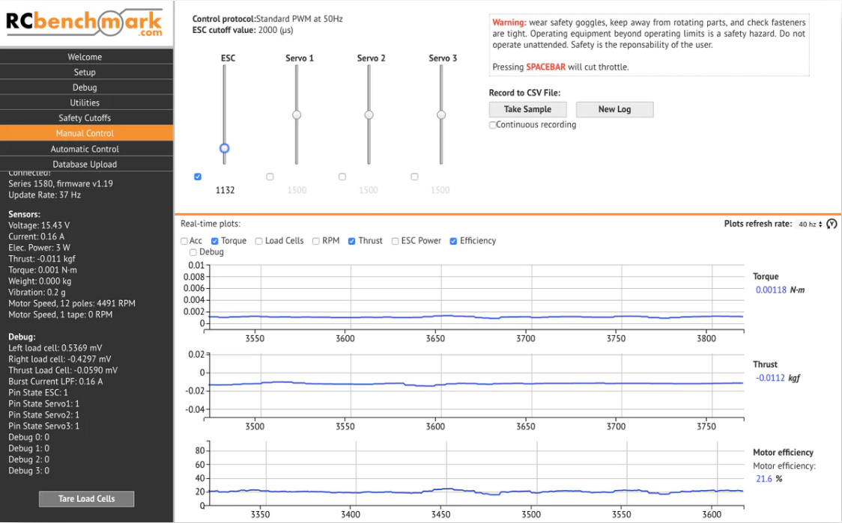
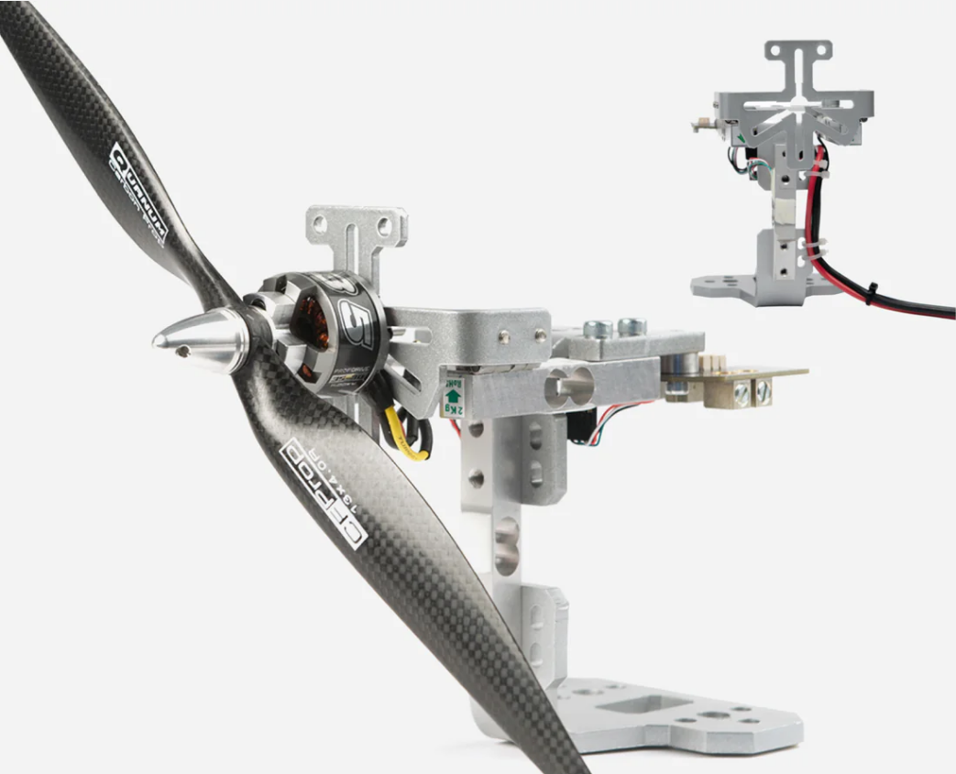
Applications
Brushless motor characterization
Propeller characterization
Calculate system efficiency
Servo testing and control
Battery endurance testing
Factory tests

Slide 4
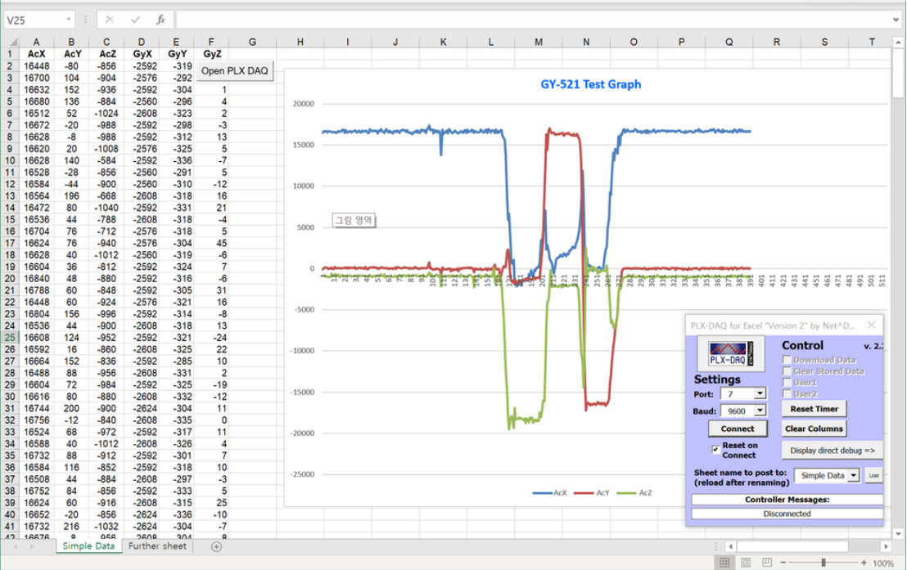
Our Project
Aims to achieve the same features
Uses off-the-shelf components
Compatible for multiple thrust and torque measurement by swapping load cells of desired capacity
Economical
Python GUI as interface
Data acquisition using PLX-DAQ, a plugin for Excel, and Visual Basic
Thrust | Load cell capacity | Accuracy (+/-0.05% *SF)
5 kgf | 5 kg | 0.001
10 kgf | 10 kg | 0.005
20 kgf | 20 kg | 0.01
Torque | Load cell capacity | Accuracy (+/-0.05% *SF)
2 Nm | 2 kg | 0.001
5 Nm | 5 kg | 0.0025

Slide 5
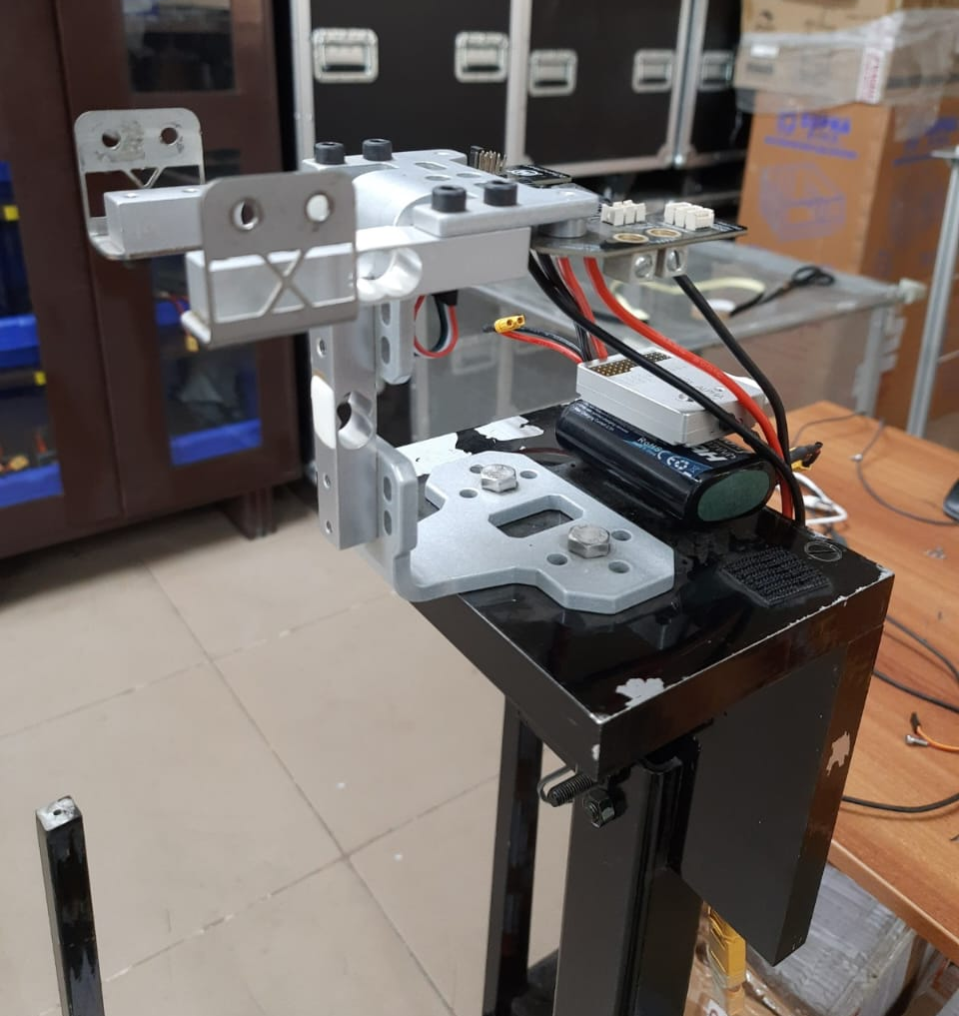
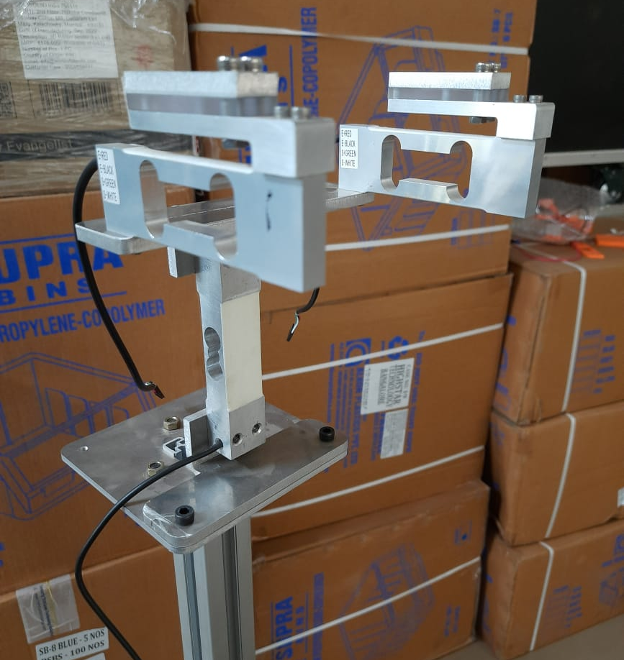
Tyto Robotics Series 1585 Thrust Stand
Thrust Bench to be worked on

Slide 6
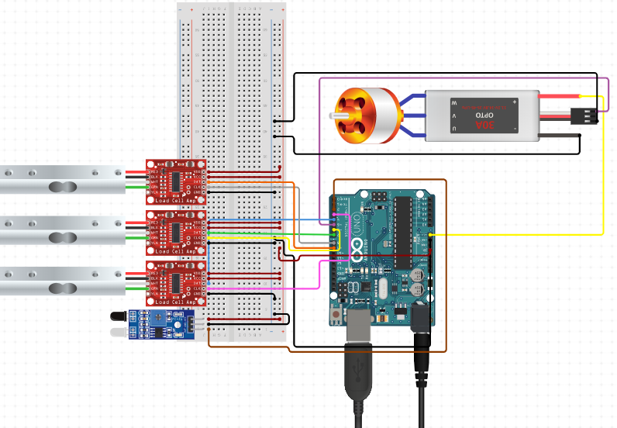


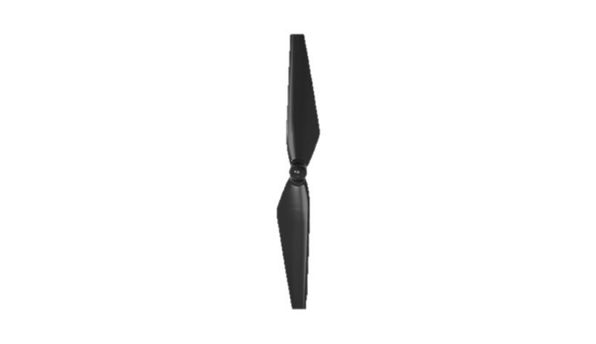
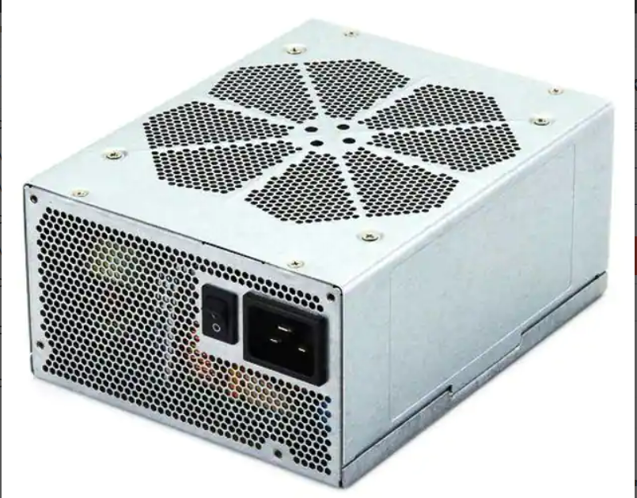
Schematic
Load Cells with HX711 Amp
Motor Control
ESC and Motor
5 kg
Thrust
2 kg
Torque
2 kg
Arduino
Microcontroller
Benchtop Supply
IR Tachometer
RPM

Slide 7
BOM
Sl No | Category | Item | Vendors | Cost per item (₹) | Quantity | Total (₹) | Part Links
1 | Load cell | SEN-14729 Miniature Load Cell - 5 kg (Parallelogram Bending beam type) | Digikey | 1086.86 | 6 | 2173.72 | https://www.digikey.in/en/products/detail/sparkfun-electronics/SEN-14729/9555603
 |  | SEN-14729 Miniature Load Cell - 2 kg (Parallelogram Bending beam type) | Digikey | 1086.86 | 4 | 4347.44 | https://www.digikey.in/en/products/detail/sparkfun-electronics/SEN-14729/9555603
 |  | SEN-14729 Miniature Load Cell - 10 kg (Parallelogram Bending beam type) | Digikey | 1086.86 | 2 | 2173.72 | https://www.digikey.in/en/products/detail/sparkfun-electronics/SEN-14729/9555603
 |  | SEN-14729 Miniature Load Cell - 20 kg (Parallelogram Bending beam type) | Digikey | 1086.86 | 2 | 2173.72 | https://www.digikey.in/en/products/detail/sparkfun-electronics/SEN-14729/9555603
2 | Load Cell Amplifier HX711 | SEN-13879 | Digikey | 907.10 | 6 | 5442.60 | https://www.digikey.in/en/products/detail/sparkfun-electronics/SEN-13879/6202732
3 | Optical Tachometer using IR sensor | Infrared Obstacle Avoidance IR Sensor Module | Robu | 28.00 | 2 | 56.00 | https://robu.in/product/ir-infrared-obstacle-avoidance-sensor-module/
4 | Reflective Tapes |  | Amazon | 150.00 | 3 | 450.00 | https://www.amazon.in/dp/B0C5VMMDSR/ref=sspa_dk_detail_1?ie=UTF8&psc=1&pd_rd_i=&pd_rd_i=B0C5VMMDSRp13NParams&sp_csd=d2lkZ2V0TmFtZT1zcF9kZXRhaWxfdGhlbWF0aWM
5 | Arduino | Arduino Uno | Robu | 1899.00 | 2 | 3798.00 | https://robu.in/product/original-arduino-uno-rev3-smd/

Slide 8
6 | Arduino shield | Proto Screw Shield 1.0 For Arduino Uno | Robu | 204.00 | 2 | 408.00 | https://robu.in/product/proto-screw-shield-assembled/
7 | Ammeter - Hall Sensor | ACS758LCB-100B-PFF-T | Digikey | 828.40 | 2 | 1656.80 | https://www.digikey.in/en/products/detail/allegro-microsystems/ACS758LCB-100B-PFF-T/2042746
8 | Voltmeter |  | Amazon | 400.00 | 2 | 800.00 | https://www.amazon.in/amiciSense-Voltmeter-3-Digit-Digital-Detector/dp/B09X18DRVN/ref=sr_1_8?crid=YA5QTV5JKT6N&keywords=dc+voltmeter&qid=1686046652&sprefix=dc+voltmete%2Caps%2C339&sr=8-8
9 | M/M Jumper Wires |  | Digikey | 173.96 | 4 | 695.84 | https://www.digikey.in/en/products/detail/sparkfun-electronics/PRT-12795/5993860?s=N4IgTCBcDaIAoCUAqBaAjGA7ATgKwgF0BfIA
10 | Male Headers Pack- Break-Away |  | Digikey | 54.67 | 2 | 109.34 | https://www.digikey.in/en/products/detail/sullins-connector-solutions/PRPC040SAAN-RC/2775214?s=N4IgTCBcDaIAoCU4GEAMAWVBlAgjgcgLQLIgC6AvkA
11 | Solderless Breadboard | GS-830 | Digikey | 766.27 | 2 | 1532.54 | https://www.digikey.in/en/products/detail/global-specialties/GS-830/5231309
12 | AC/DC WALL MOUNT ADAPTER 12V 24W | PSAC24A-120L6 | Digikey | 932.78 | 1 | 932.78 | https://www.digikey.in/en/products/detail/phihong-usa/PSAC24A-120L6/5418494
13 | PCB Prototype Board | 4 x 6 cm Universal PCB Prototype Board Double-Side -2pcs | Robu | 40.00 | 2 | 80.00 | https://robu.in/product/46-cm-universal-pcb-prototype-board-double-sided/
Total Hardware Cost: ₹ 31177.94

Slide 9
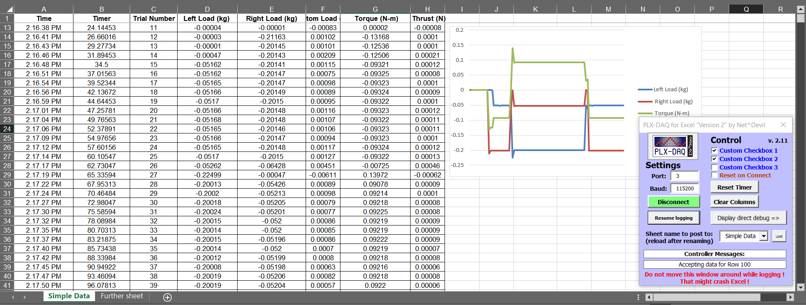
Interface

Slide 10
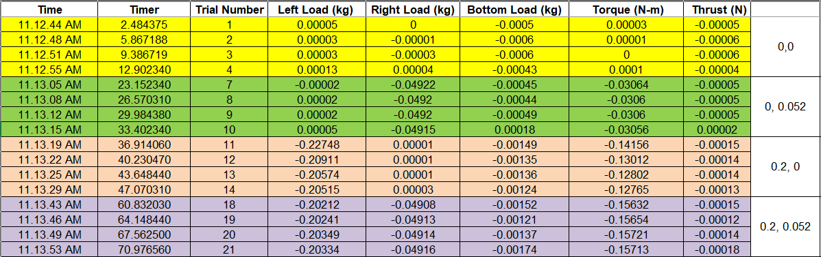
Trial Data
Torque = (RL-LL kg)*(0.127 m/2)*9.18 m/s2
Thrust = (BL) kgf

Slide 11
